Slide 1
Adult Income Prediction
20XX
Machine Learning Project

Slide 2
Data Exploration and Visualization
20XX
Individuals income if they are below or above a certain threshold (50,000) based on several characteristics

Slide 3
Adult Dataset
Type | Feature | Id
numeric | Age | 1
categorical | workclass | 2
numeric | fnlwgt | 3
categorical | education | 4
numeric | education_num | 5
categorical | martial_status | 6
categorical | occupation | 7
categorical | relationship | 8
categorical | race | 9
categorical | sex | 10
numeric | capital_gain | 11
numeric | capital_loss | 12
numeric | hours_per_week | 13
categorical | native country | 14
From UCI, about 49000 samples

Slide 4
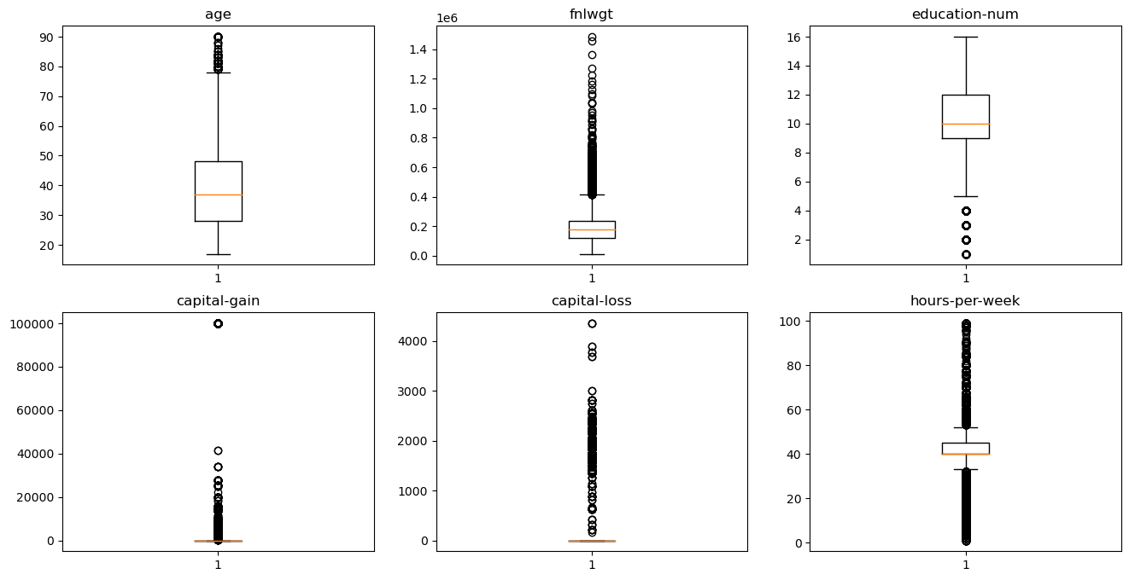
Boxplot for Numerical

Slide 5
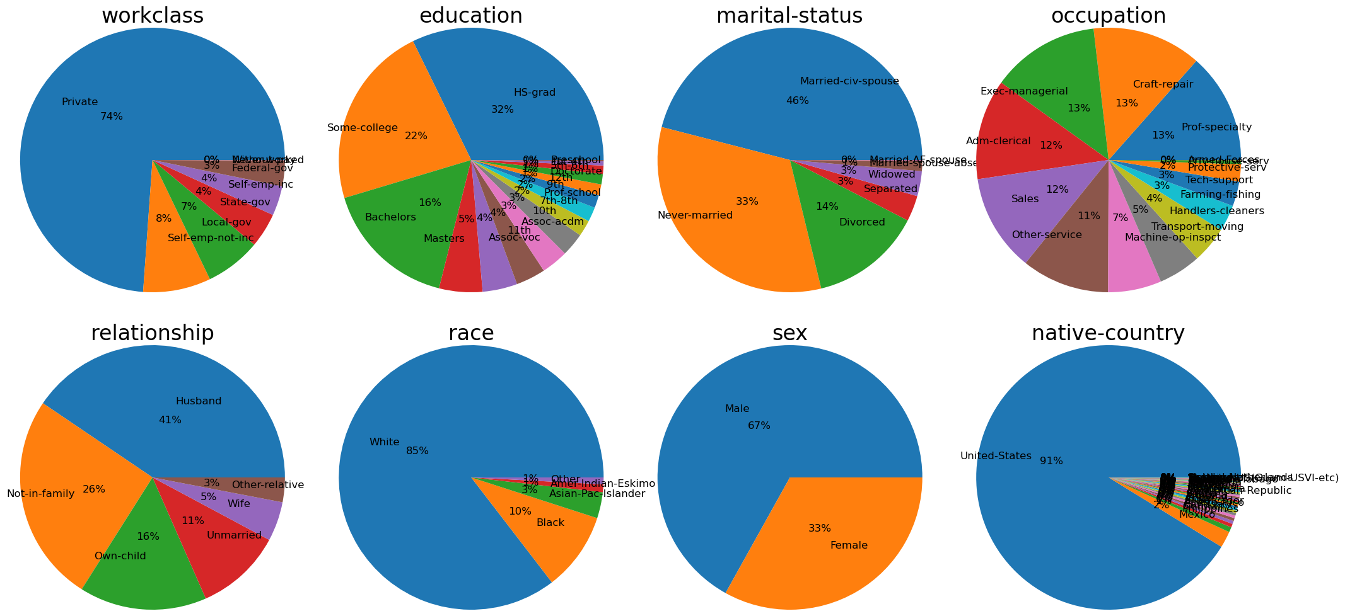
Pie Chart for Categorical

Slide 6

Data Mining
20XX

Slide 7
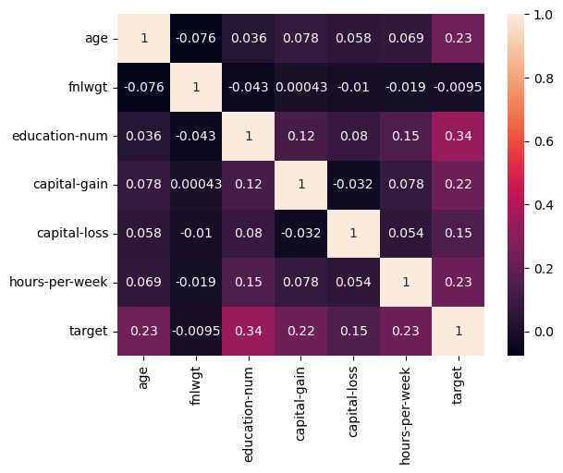
Correlations
Correlations for Numerical and Target
numerical features have low correlation with each other.
the fnlwgt feature has low correlation with the target.

Slide 8
Aage Feature
20XX
Histogram
Explanation
when age increase, incom does. so there is a positive relatrion between age and target.

Slide 9
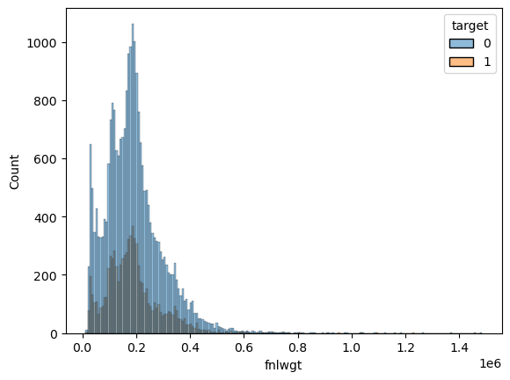
Final Weight
20XX
Explanation
fnlwgt has similar variance for target classes which means it is not useful to make prediction.
Fraction = 1.07817

Slide 10
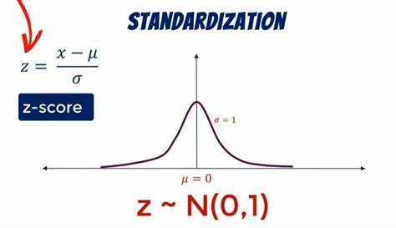
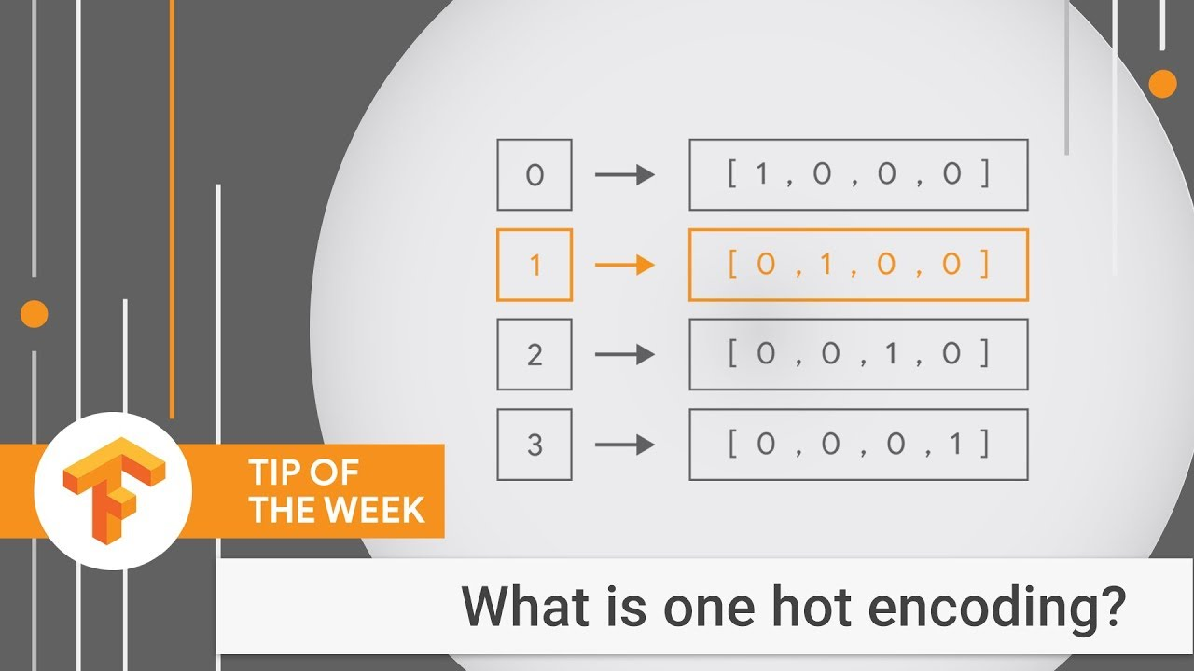
Preprocessing
Z-score scaling
One Hot Encoding

Slide 11
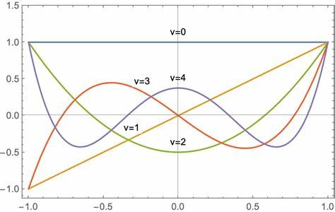
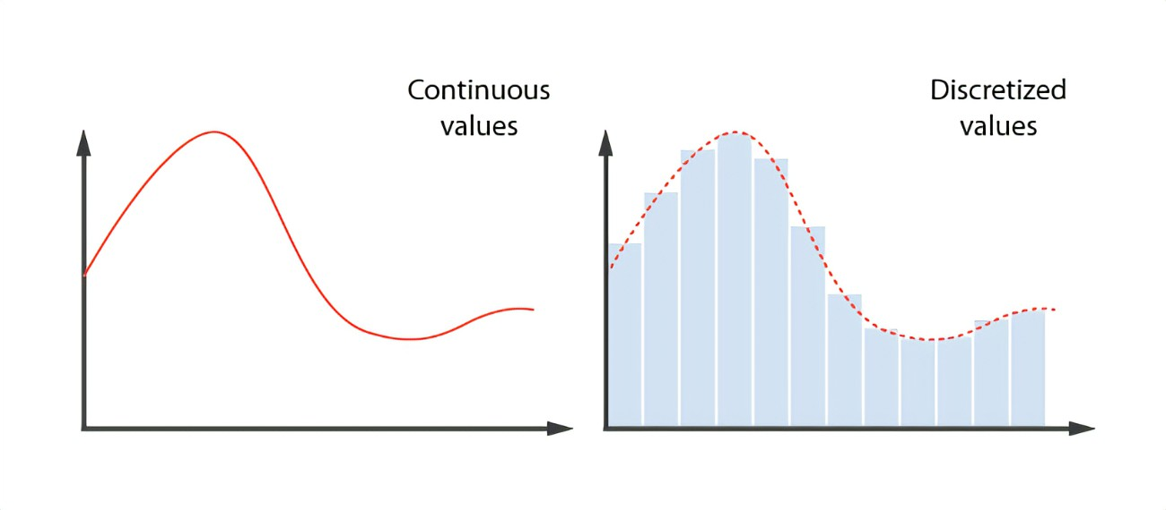
Feature Extraction
Polynomial features
Discretization continuous features

Slide 12

Training
20XX

Slide 13
Experiments
ROC | accuracy | Model
- | 75% | Dummy classifier
0.911 | %85 | Logistic regression
0.905 | %85 | K-nearest neighbor
0.896 | %85 | Decision tree
0.926 | %86.7 | AdaBoost
0.929 | %86.7 | Gradient Boosting
Considering AUC for Optimization

Slide 14
The Best Model
The best model with the highest accuracy and generalization is GBoost with a maximum depth of 4 and a number of estimators equal to 250.
AdaBoost model also achieved similar results.
Gradient Boost Classifier

Slide 15

Testing

Slide 16
Testing Scores
auc | precision | recall | accuracy
0.92619429 | 0.77977111 | 0.65548621 | 0.87488483

Slide 17
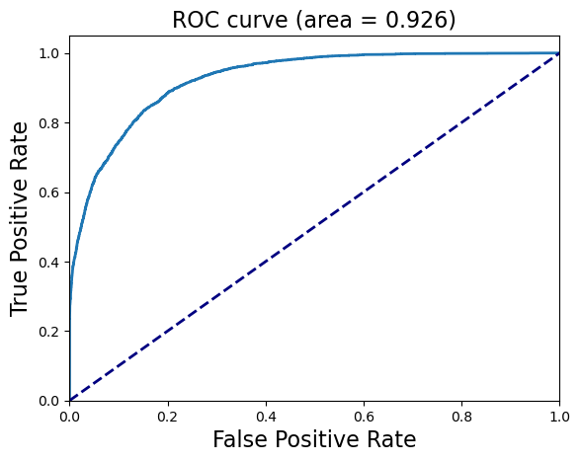
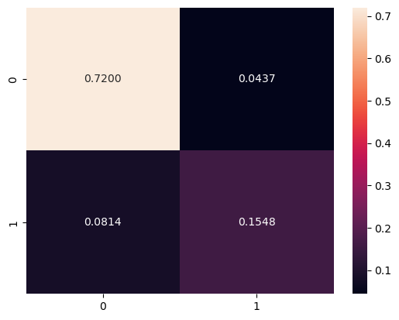
ROC Curve
Confusion Matrix

Slide 18
THANK YOU!
20XX
ML Godfather

